Slide 1
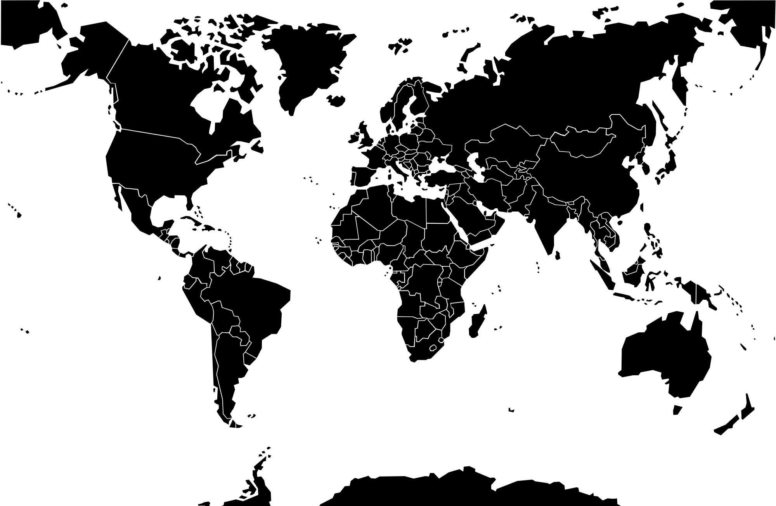
Megatonage
1945
1955
1965
1975
1985
1995
2005
2015
2025
Underground
Notes:
Y axis- altitude dropped from
Siesmic yeild- Johnson Arch
X-axis
Feedback
Do 8 different versions of the chart rather than trying to make 1 interactive chart
Remove the map and use that space for your “Give Peace a chance” story”
Minimize

Slide 2
A Thousand Suns
November 1965:
Total Bombs: 1450
An Atlas of The Global Nuclear Arms Race from 1945-Present
DRK: 30
China: 99
France: 140
USSR: 540
USA : 660
Kilo Tons
1945
1955
1965
1975
1985
1995
2005
2015
2025
Underground
Notes:
Y axis- altitude dropped from
Siesmic yeild- Johnson Arch
X-axis
Feedback
Do 8 different versions of the chart rather than trying to make 1 interactive chart
Remove the map and use that space for your “Give Peace a chance” story”
Minimize

Slide 3
A Thousand Suns
November 1965:
Total Bombs: 1450
An Atlas of The Global Nuclear Arms Race from 1945-Present
DRK: 30
China: 99
France: 140
USSR: 540
USA : 660
Kilo Tons
Try a gantt chart like
appraocha
1945
1955
1965
1975
1985
1995
2005
2015
2025
Underground
Notes:
Y axis- altitude dropped from
Siesmic yeild- Johnson Arch
X-axis
Feedback
Do 8 different versions of the chart rather than trying to make 1 interactive chart
Remove the map and use that space for your “Give Peace a chance” story”
Minimize

